Slide 1
POSITION AND DISPLACEMENT

Slide 2
POSITION
Position is a place where someone or something is located or has been put.
In physics, position is usually a number on an axis. A number where direction doesn't matter is called a scalar.
Position is a vector, because direction matters.

Slide 3
About position
It is generally in reference to some coordinate system.
This gives us the opportunity of assigning it a numerical value x.
The function x(t) tells us the evolution of position,
i.e., the location of the particle as a function of time.
Notation:
$x_{o}$= x($t_{o}$) is not $x_{o}$ = 0
$x_{1}$ = x($t_{1}$)
$x_{2}$= x($t_{2}$)

Slide 4
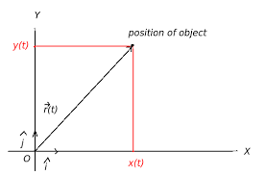
Representation of position of an object

Slide 5
Cont..

Slide 6
Requirements or factors
The main factors to determine the position of the object are :-
observer frame
coordinates
whether the object is at rest or in motion .

Slide 7
How can we specify the position of an object?
The motion of an object can be described by using its position, speed, direction, and acceleration.
In fact, an object is moving if its position is relative to a fixed point and it is changing towards even things appear to be rest move.

Slide 8
Mean position and Extreme position
A mean position is any position that is a moderate position between two other extreme positions.
It is understood as a middle-of-the-road position or compromise between two extreme views.
The mean position may still be extreme and what is a mean position in one context can be an extreme position in another.

Slide 9
Cont..
An extreme position can be understood as in the simple pendulum when bob has maximum displacement w.r.t its mean position.
As bob is at it’s highest point in this position, it’s potential energy is maximum and kinetic energy is minimum.
In extreme position, both velocity and acceleration is zero.

Slide 10
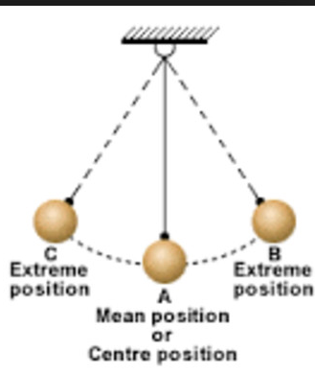
Representation of mean and extreme position

Slide 11
DISPLACEMENT
Definition: Displacement is a change in position .
Quantity: It has a direction, Therefore, it is a vector quantity.
Change has a very specific meaning in physics. It is the final value of a quantity minus the initial value.
Change indicated by upper case delta: Δ
Thus a change in position x is given by:
Δx = $x_{f }$- $x_{i }$
The displacement is a signed quantity

Slide 12
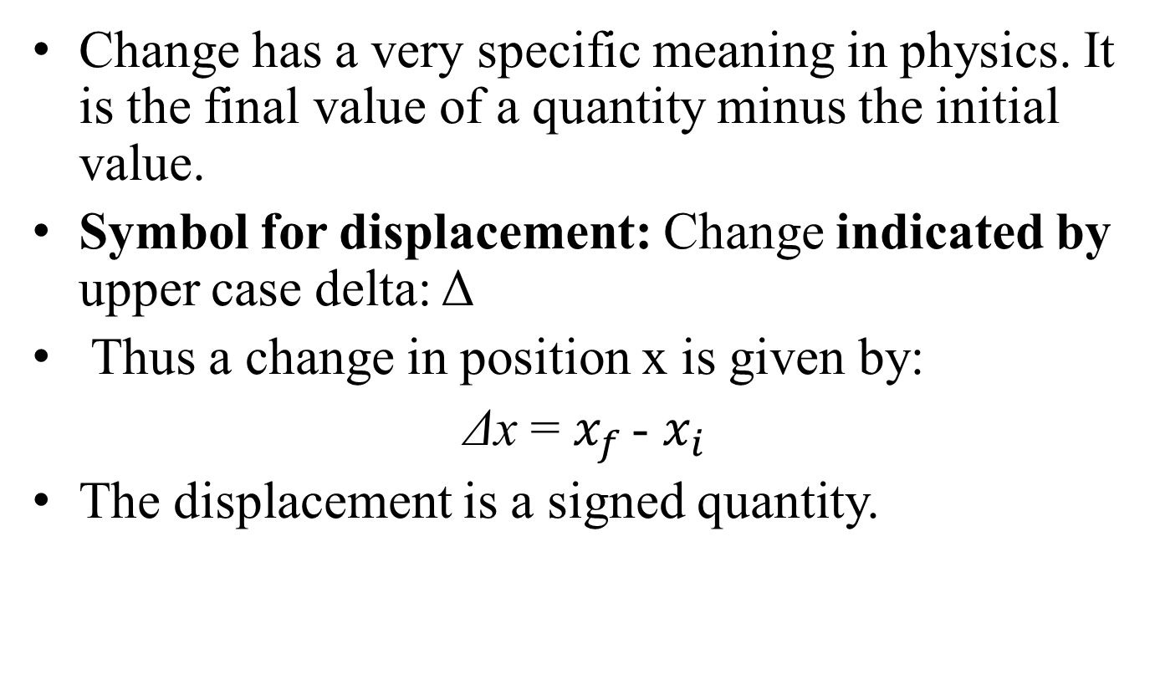
What is change in position?
Change has a very specific meaning in physics. It is the final value of a quantity minus the initial value.
Symbol for displacement: Change indicated by upper case delta: Δ
Thus a change in position x is given by:
Δx = $x_{f }$- $x_{i }$
The displacement is a signed quantity.

Slide 13
Units
The SI units for the displacement is :
Meter(m)

Slide 14
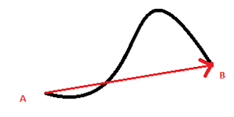
Representation of displacement

Slide 15
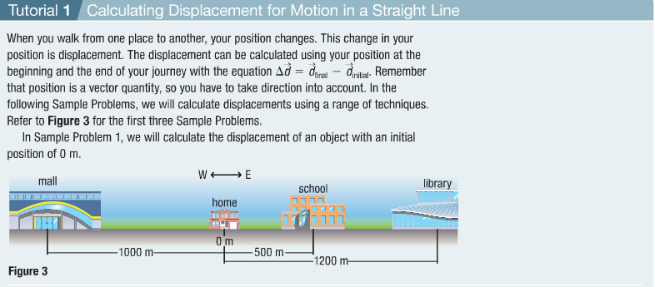
Cont..

